Slide 1
General Approach to Data Science
Bhuvan M S
msbhuvanbhuvi@gmail.com

Slide 2
Contents
Scope of Data Science
Skills for a Data Scientist
How to approach towards a data centric solution to a problem?
Analysis Pipeline
Tools for implementing
Deployment Framework
Note on NLP specific approach

Slide 3
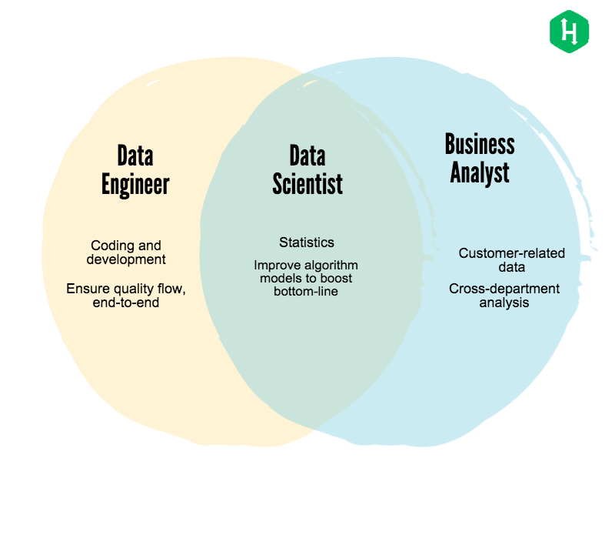
Scope of Data Science

Slide 4
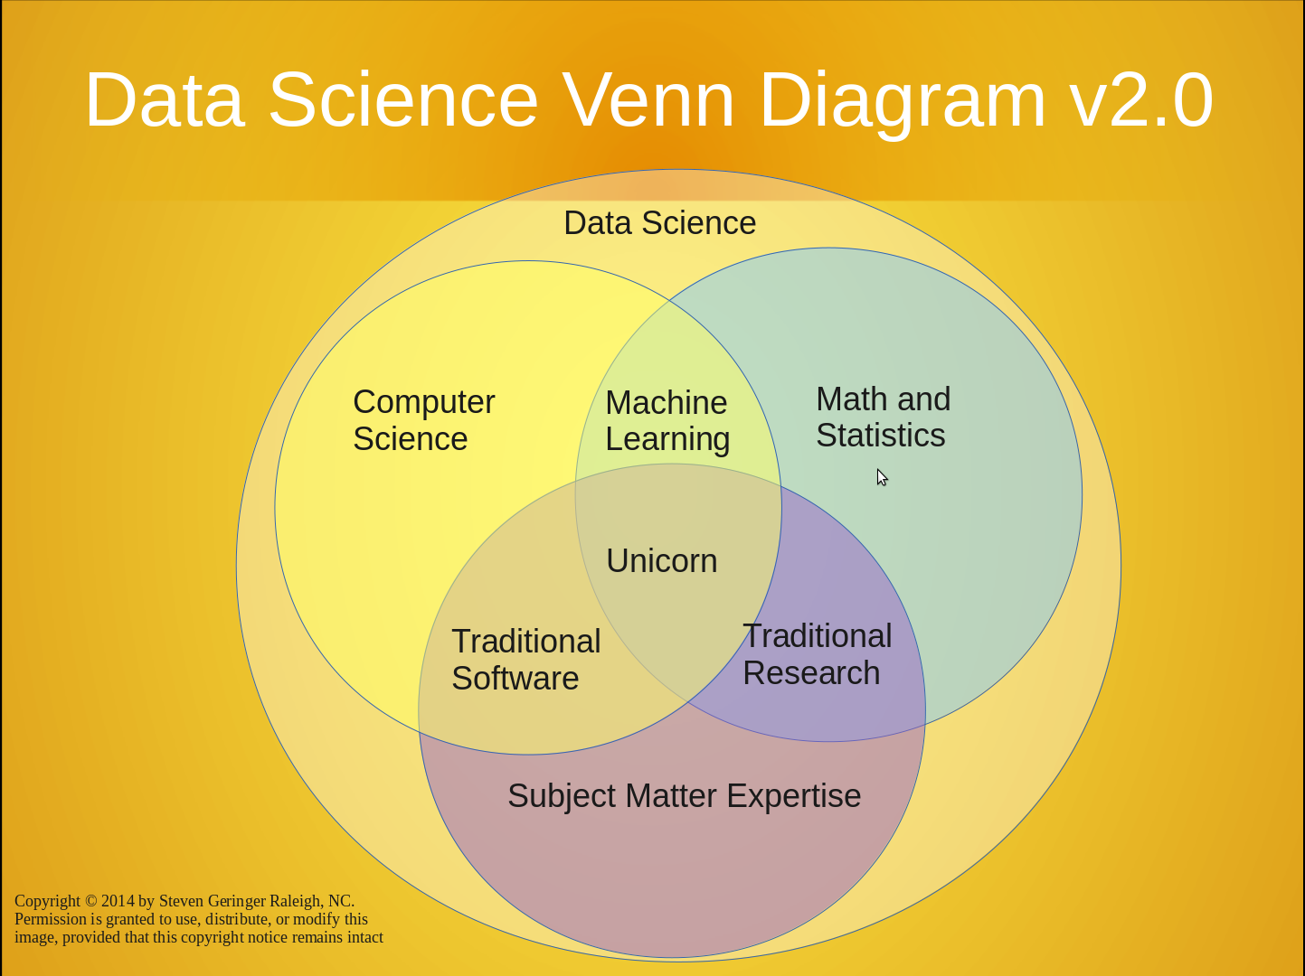

Slide 5
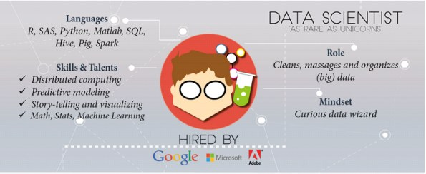

Slide 6
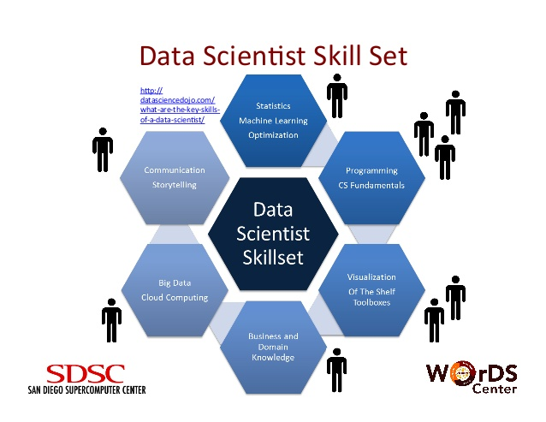
Skills of a Data Scientist

Slide 7
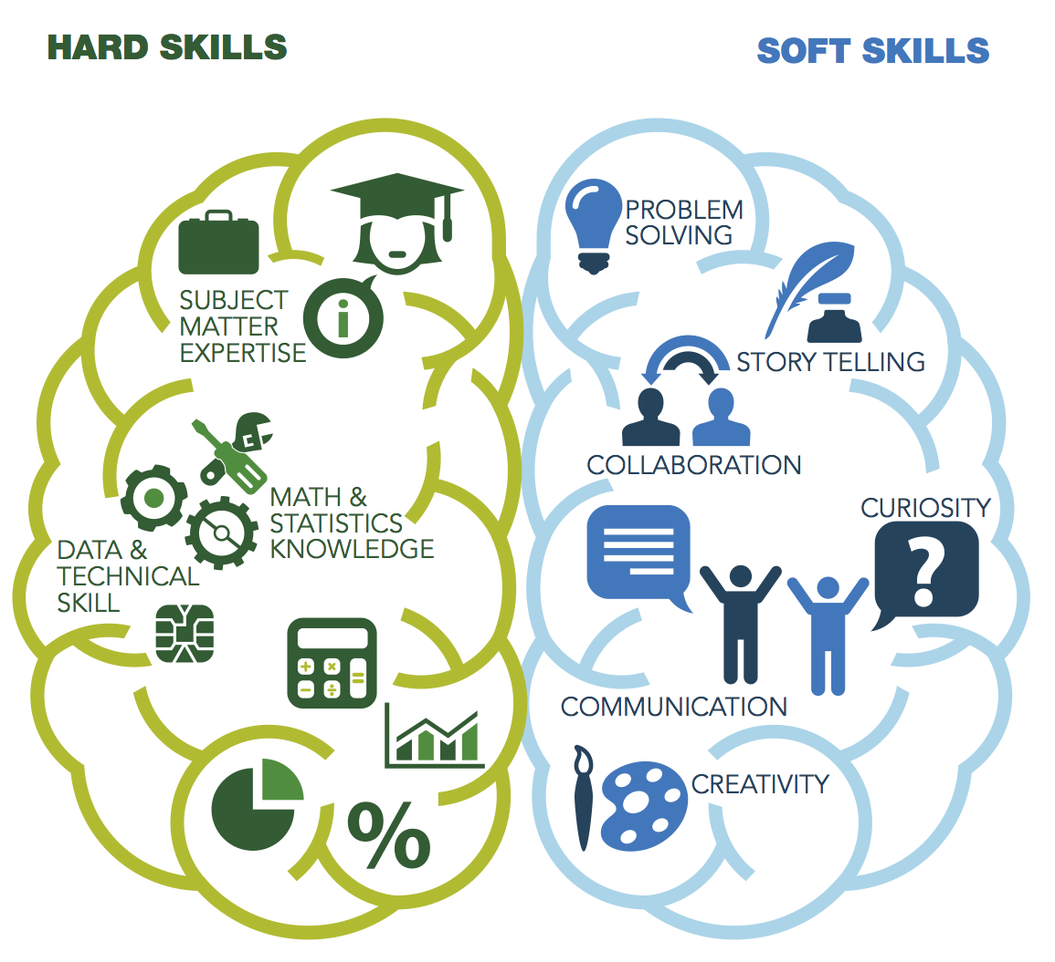

Slide 8
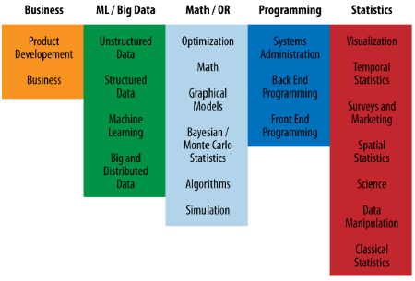

Slide 9
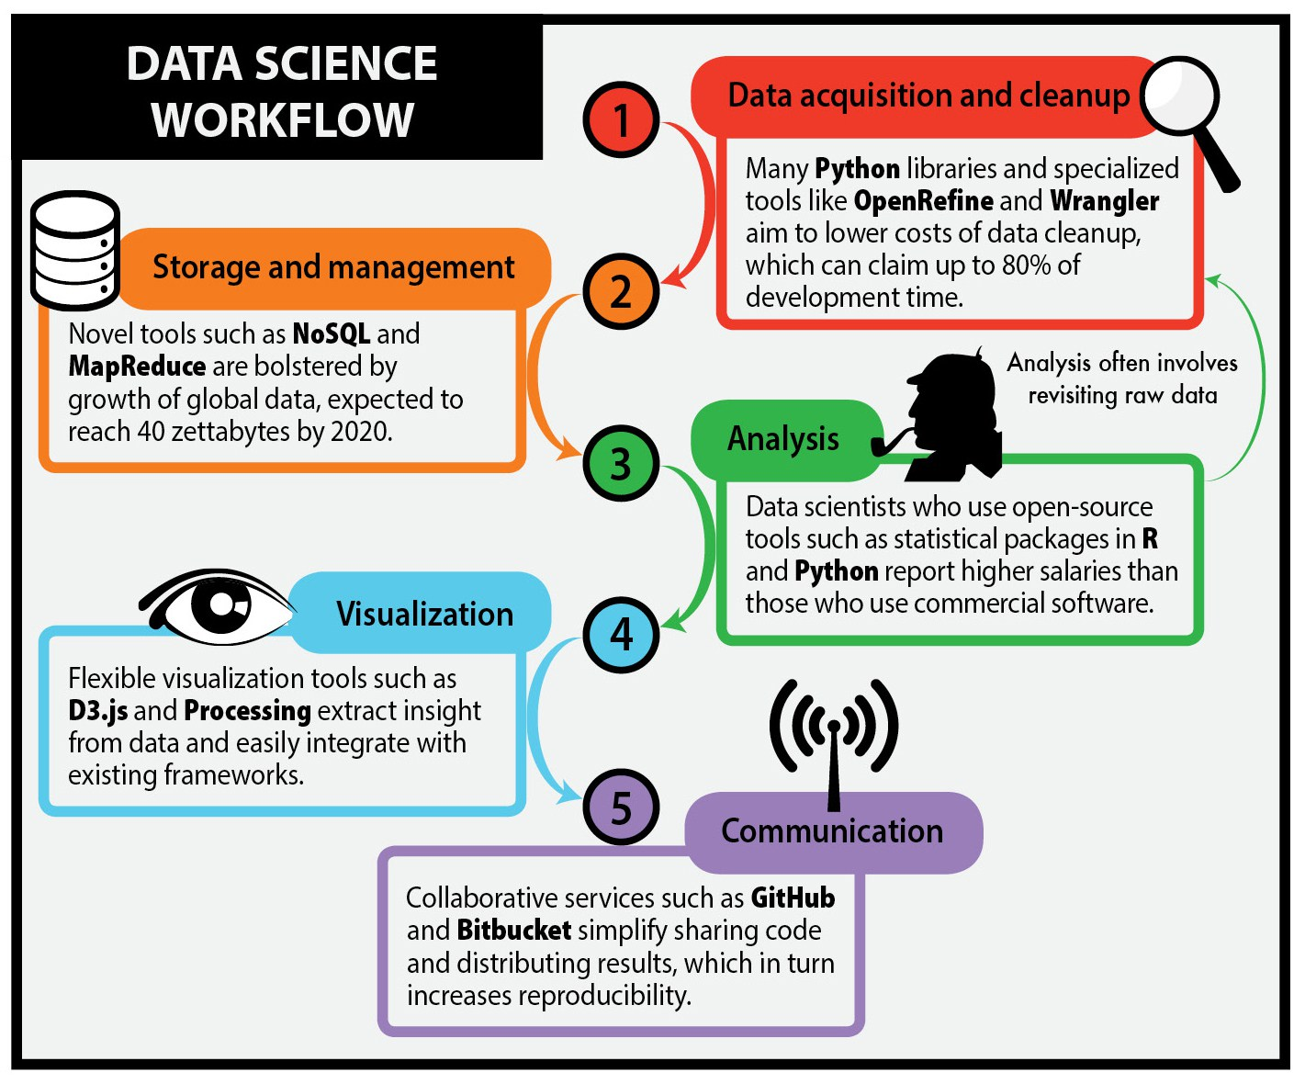
The Process and Workflow

Slide 10
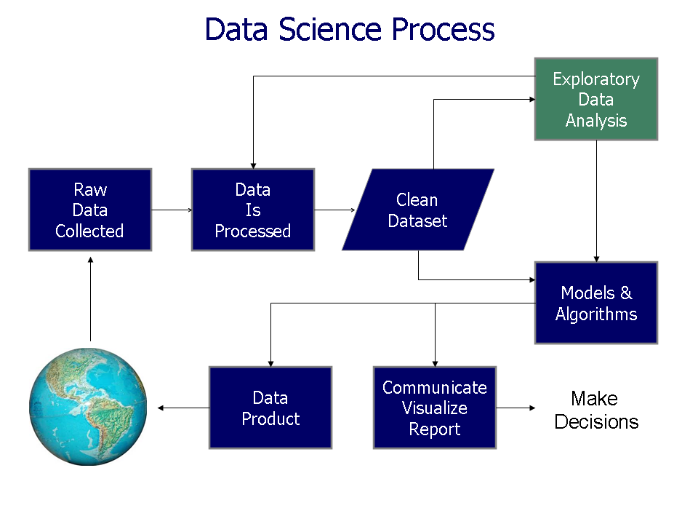

Slide 11
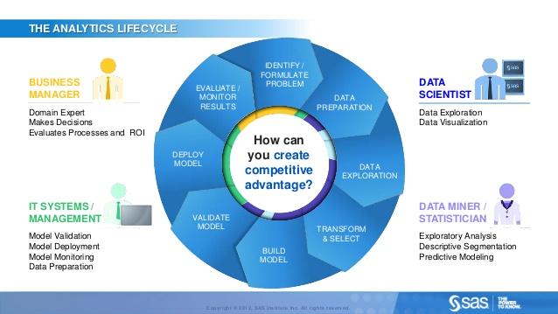

Slide 12
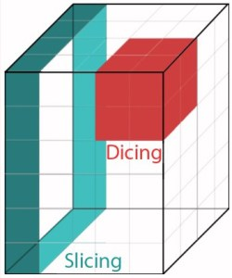
Exploratory Data Analysis
Slicing and Dicing
Suggest hypotheses about the causes of observed phenomena
Assess assumptions on which statistical inference will be based
Support the selection of appropriate statistical tools and techniques
Provide a basis for further data collection through surveys or experiments.

Slide 13
Feature Engineering
Features: The dimensions of the data!
Data Types: Binary, Numeric, Categorical, Ordinal
Features Identification
Features Extraction

Slide 14
Data Preprocessing
Data Distribution and Data Scale observation
Data Integration
Data cleaning
Missing values
Noise
Dimensionality reduction
PCA
Correlation Analysis
Data Transformation: Normalization
Data Type specific

Slide 15
Machine Learning

Slide 16
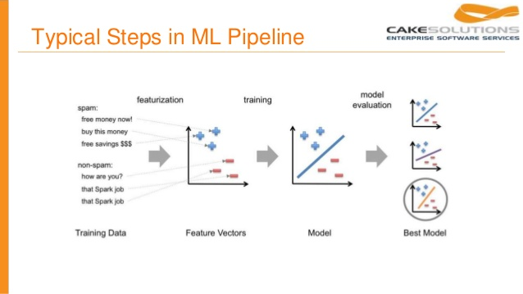
ML pipeline

Slide 17
ML Techniques
Supervised:
Classification
Unsupervised
Rule Based Classification
Clustering
Association Rule Mining

Slide 18
Feature Importance Mining
Feature Weights
Ablation Study
Random Forests

Slide 19
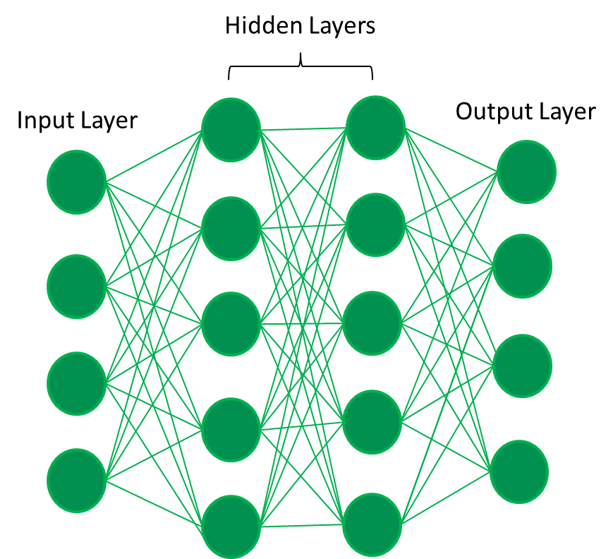
Deep Learning
Neural Networks
Classification
Auto-encoders
Automatic Feature Learning
Self Organizing Maps
Clustering

Slide 20
Evaluation and Tuning
Accuracy
RMSE
F1 measure
Precision and Recall
Receiver Operating Characteristics (ROC)

Slide 21
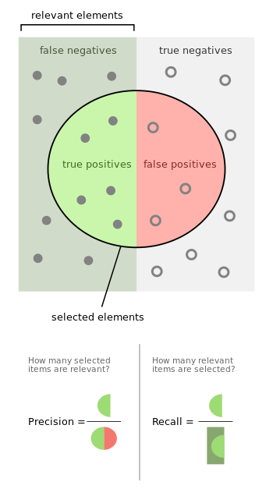

Slide 22
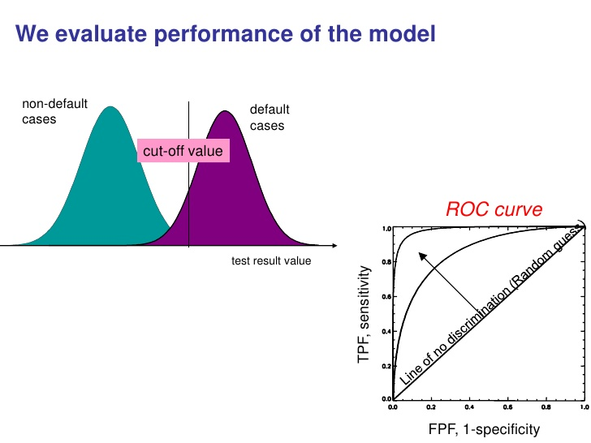

Slide 23
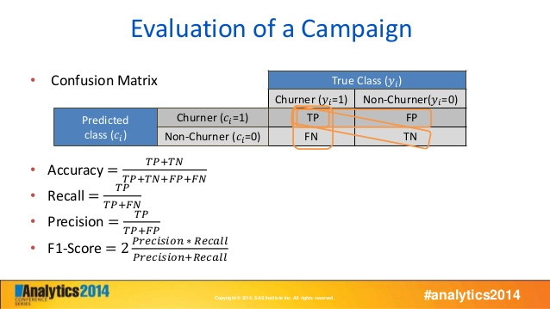

Slide 24
Tools
Programming
Python: Scikit-Learn, Py-Weka, NLTK, PyBrain
PySpark: mllib (distributed)
R
Matlab, Neural Network Toolkit, Image Processing Toolkit
Experimentation
Weka: Explorer, Experimenter, Knowledge Flow
Visualization
Python: matplotlib
Tableau
D3 js

Slide 25
Deployment Frameworks
Database: Scalable, Distributed
Graph Based: Neo4j
Document Store: MangoDB
Other: HDFS, Spark (RDD)
Handle Big Data – Map Reduce Programming Paradigm
Apache Spark
MLLIB
Streaming
Apache Storm
Topology – Spout, Bolt

Slide 26
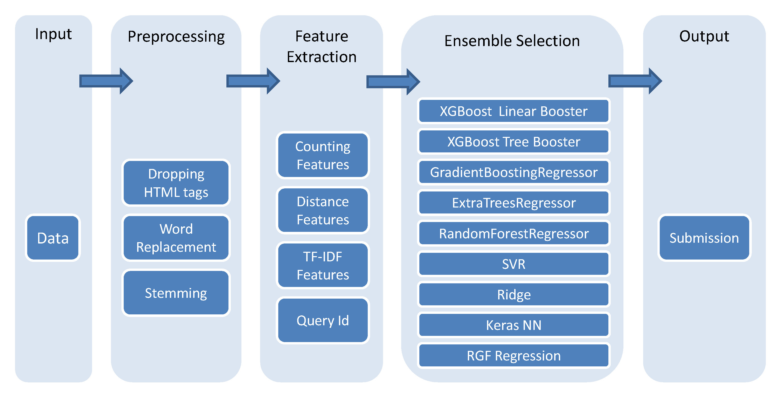
NLP – Natural Language Processing

Slide 27
Questions?

Slide 28
Thank you

